Slide 1
The industrial revolution and the Victorian age

Slide 2
The Victorian Age 1819 - 1901

Slide 3
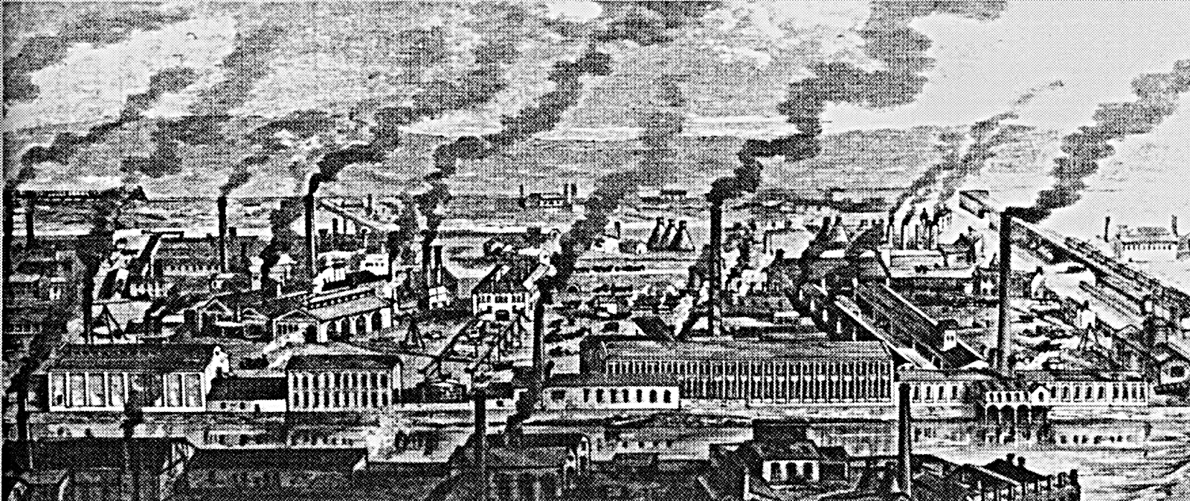
The Industrial revolution
The Industrial Revolution moved Britain from a land of small towns to a land of large cities with factories. The population grew from 16 million in 1801 to over 41 million in 1901.

Slide 4
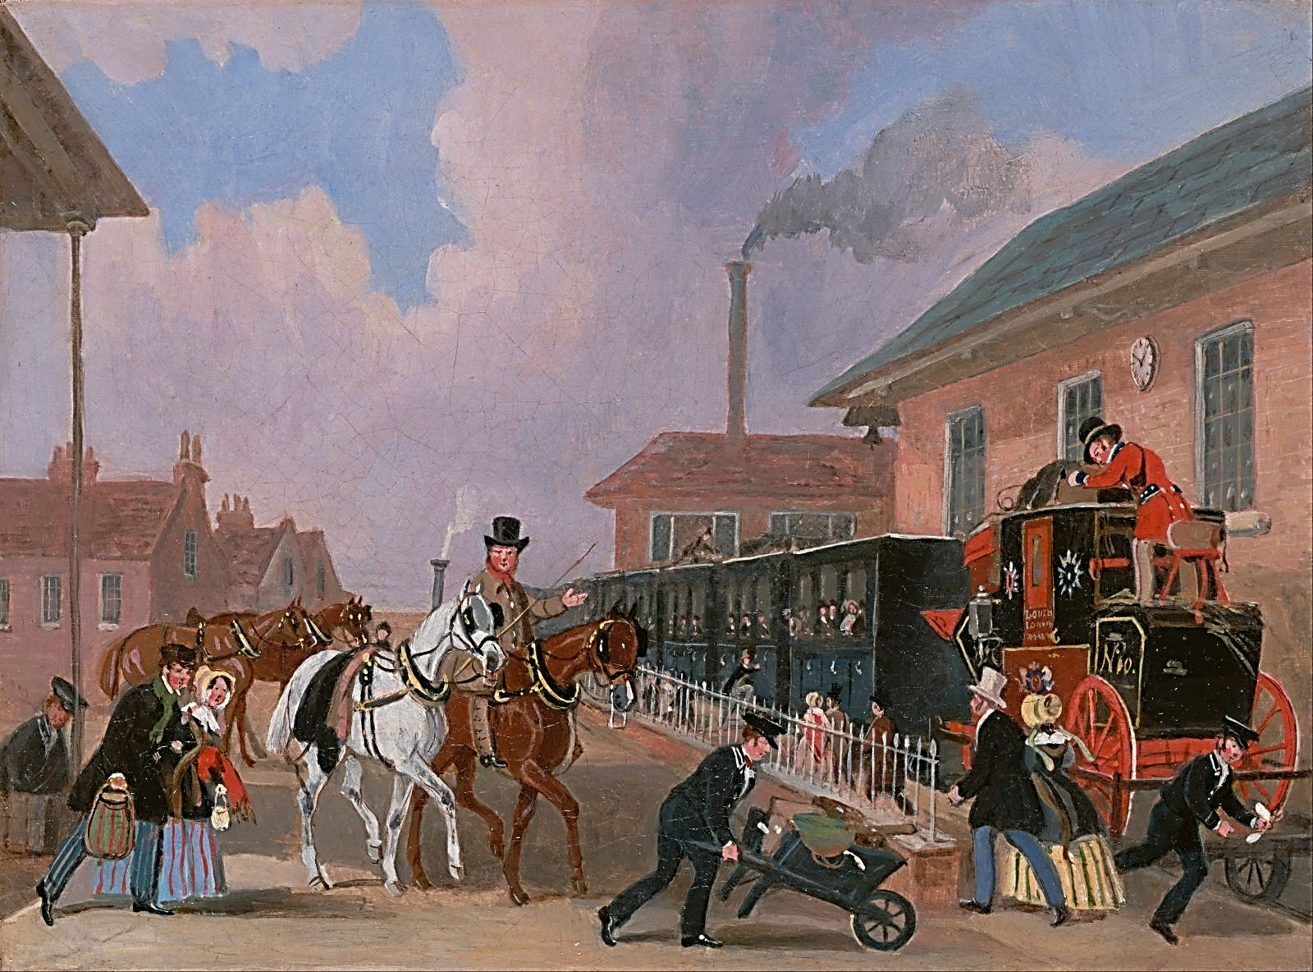
Features of the society
In Victorian literature, from 1830 to 1870, you can see Britain underwent changes that transformed people´s life. British manufacturing has become dominant in the world. Trade and the financial sector have also grown. British power and influence outside the country expanded and seemed permanent.

Slide 5
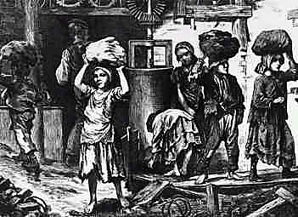
The working conditions
Most of the energy we use today comes in the form of electricity or oil. In Victorian times, energy came from water-power, from horses, and especially from coal burning. Coal was important to the Victorians as oil is to us today. Steam engines ran factory machines, locomotives pulling trains and steamships.

Slide 6
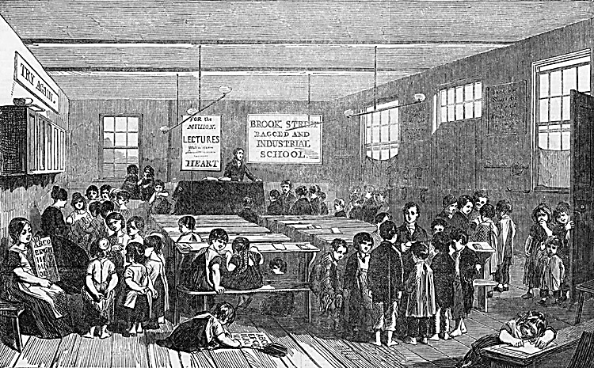
Children at work
Many families had 10 or more children.
Children from richer homes were well fed, wore warm clothes, and had shoes.
The poor children looked thin and hungry, wore tattered clothes and, some had no shoes. The poor boys had to work, lucky enough to go to school. Families had no money unless they worked.
The Industrial Revolution created new jobs in factories and mines. Many of these jobs were done mostly by children. Many children started working at 5 years of age.

Slide 7
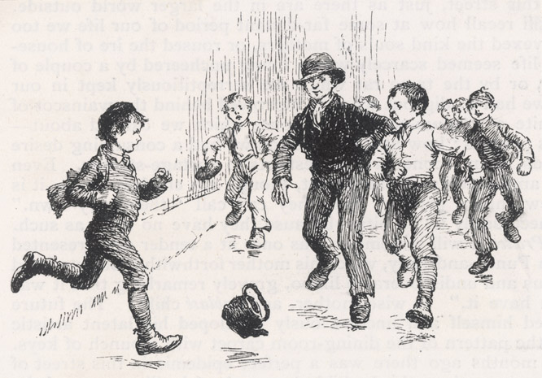
Children at play
Although many children worked in Victorian times, they still had time to play. Most children played in the streets in the fields or in the woods. With ten or more children together, it was a luxury for the poor to have a place to play. If they did not have a proper ball, they would make balls of old rags.

Slide 8
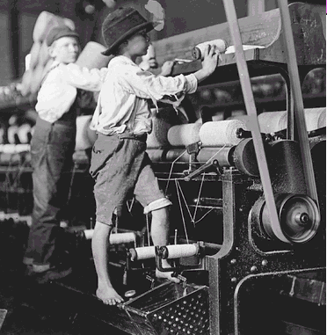
Children in factories
Britain was the first country in the world to have many factories. The machines did jobs, like wiring, that were done by families at home. They breathed air filled with dust and oil. The iron and steel works were so hot that the workers dripped with sweat.

Slide 9
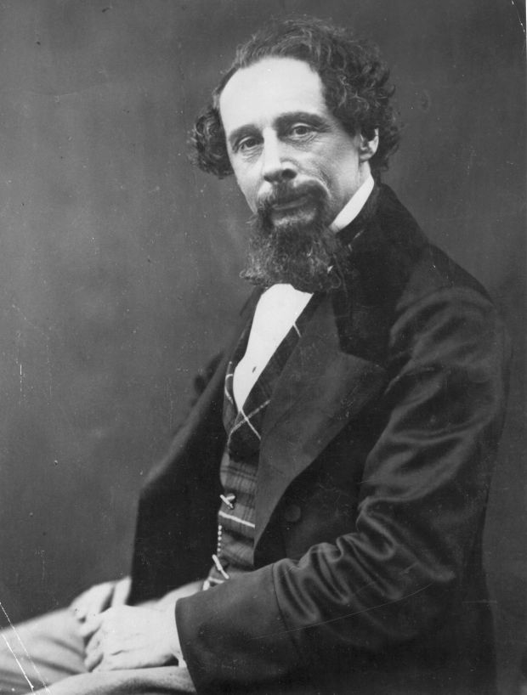
Charles Dickens books
Charles John Huffam Dickens was born on February 7, 1812 and died on June 9, 1870. He was an English social writer and critic. He has created some of the best-known fictional characters in the world and is considered the greatest novelist of the Victorian era.

Slide 10
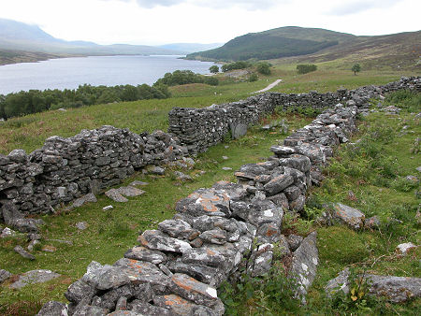
Highland Clearances
Before 1755, more than half of the people of Scotland lived in the Highlands. Most Scots spoke Gaelic, a language similar to Irish. Many Scots belonged to clans. The clan members gave their support to their boss in exchange for protection and leadership.

Slide 11
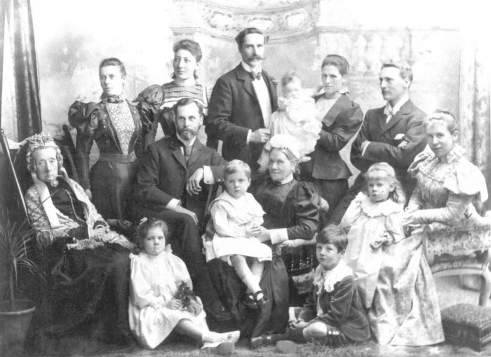
Rich and poor families
Queen Victoria had nine children. She gave them the names of Edward, Alfred, Arthur, Leopold, Victoria, Alice, Helen, Louise and Beatrice. The royal family became a role model for other families. In the nursery, younger children ate, touched, and slept. Many poor families lived in small country houses.

Slide 12
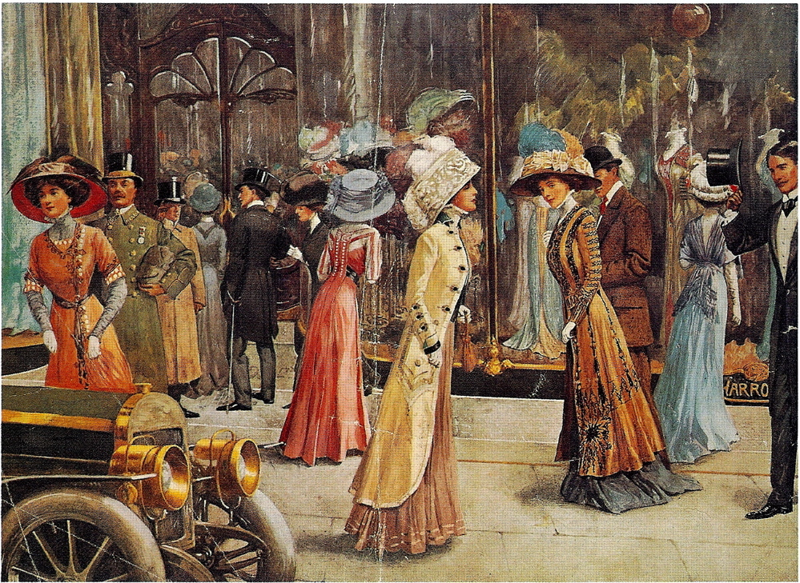
Victorian Scotland
Queen Victoria was so fond of the Highlands of Scotland that she and her husband, Prince Albert, bought Balmoral Castle in 1848.

Slide 13
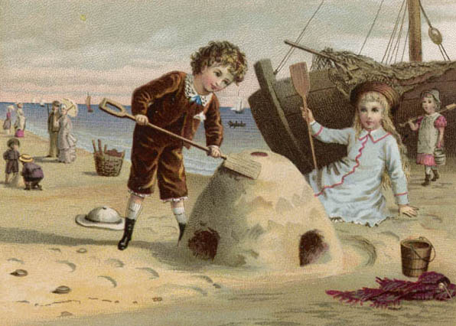
leisure
At weekends, rich families could go to the park and, listen to a band. They could also go to the beach or go to the zoo. At Easter, there was "Maypole" dancing. The May Queen was chosen, and paraded through the streets. Poor families looked forward to treatments such as day trips and picnics. These were often run by youth organizations such as the Band of Hope and the Boys Brigade.

Slide 14
Work done by:
Inês cruz, number 10
Joana almeida, number 11
Mariana santos, number 17
6ºF

