Slide 1
The Speckled Band English Literature

Slide 2
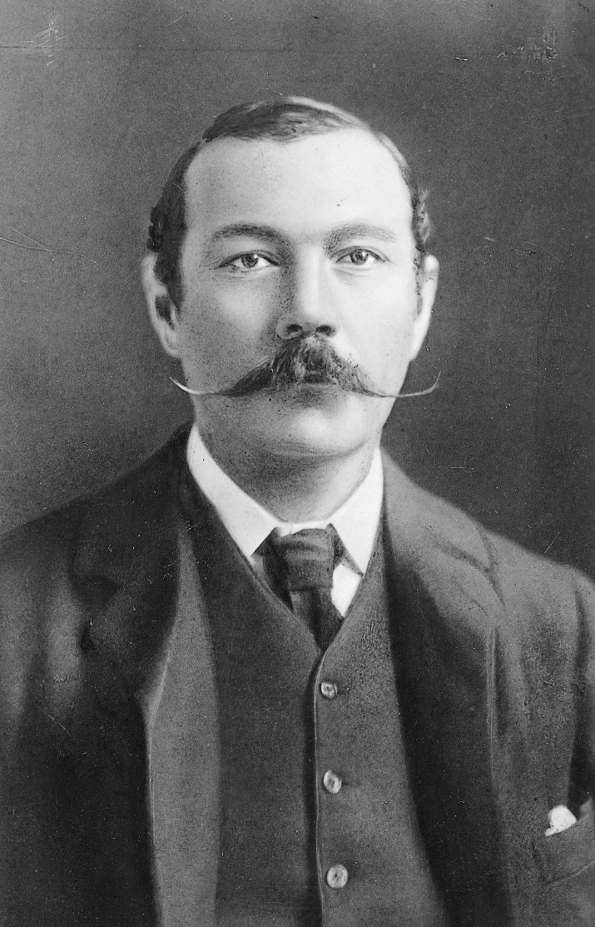
Sir Arthur Conan Doyle

Slide 3
Index:
Plot;
Stage;
Characters;
Action;
Summary;
Interesting aspects about the story;
Your views;

Slide 4
Plot
In The Adventure of the Speckled Band, Sherlock Holmes investigates the case of a young bride to be who fears that she'll be murdered. Helen Stoner, the stepdaughter of Sir Grimesby Roylott, has reason to believe that her stepfather killed her sister—she just doesn't know how. At the end, Holmes discovers that Roylott was using a snake (the "speckled band").

Slide 5
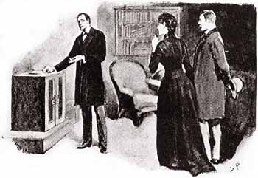
Plot
Our favourite part is when they are inside the room, looking at the everything to find out clues and to find out what happened.

Slide 6
Stage
It's early April 1883, and Holmes wakes Watson at 7:15am to tell him that a young lady has come to Holmes with a case.
In the sitting room there is a lady of around thirty, dressed in black with a black veil, who's shaking with fear. She's desperate for help, and promises Holmes that, while she can't pay him anything now, she'll be married soon and have control of her own income. He's in this business for the pleasure of the hunt. So, he says, let's hear your story.
The lady's name is Helen Stoner, and she's living with her stepdad.

Slide 7
Stage
This stepdad is the last living member of a great English family, the Roylotts. The Roylotts once controlled huge tracts of land, but after generations of spending lots of money, nothing is left of the estate except an old house, heavily mortgaged.
Miss Stoner also has a twin sister, Julia.
Miss Stoner's mother was left with quite a lot of money –But her will does allow for some of that money to go to Miss Stoner and to Julia if/when the girls get married.

Slide 8
Stage
With the money his wife has left him, Roylott takes Miss Stoner and Julia away from London and to his old family home in Stoke Moran. For their part, Miss Stoner and Julia are psyched to go: they think they'll be happy there.
But then – Roylott changes. He becomes violent and starts frightening away all the neighbors. He has no friends.

Slide 9
Stage
Two weeks before the date of the wedding, Julia is killed.
At about 11pm, Julia heads back to her room to sleep, but before she goes, she asks Miss Stoner if she has ever heard anyone whistling in the middle of the night.
Miss Stoner says no.
Julia tells her sister that, for the past few nights, always at around 3am, she has heard a low whistle that has awakened her. But she can't hear where it's coming from.

Slide 10
Stage
That, for the past few nights, always at around 3am, she has heard a low whistle that has awakened her. But she can't hear where it's coming from.
Miss Stoner mentions that she and Julia have always locked their doors before sleeping because they're afraid of the cheetah and the baboon.
That night, Miss Stoner can't sleep. And sure enough, in the middle of the night, she hears a woman screaming: it's Julia!
Miss Stoner runs to Julia's room, where the door is curiously unlocked.

Slide 11
Stage
Miss Stoner sees Julia, her face terrified, her body swaying, appear in the doorway.
Julia starts to convulse, but is able to say, "Oh, my God! Helen! It was the band! The speckled band!" (Speckled. 50).
He rushes to help Julia, but she's already unconscious. Julia dies.
Julia's windows were locked and barred, and there were no bruises or anything on her body. There's also no evidence of poison.

Slide 12
Stage
So she has come to Holmes to ask for his protection.
Holmes says Miss Stoner's made the right choice.
Holmes begins his investigation.
He suggests that an animal is inside, because there's a saucer of milk on top of the safe.
Holmes seems to have figured it all out by looking at these clues, but Watson and Miss Stoner are still lost.
He also admits that he has no clue what's going on.

Slide 13
Stage
He's watching the ventilator carefully.
Suddenly, they hear a terrible yell. Holmes tells Watson to bring his gun, and they enter Roylott's room.
Roylott is dead, sitting in his wooden chair with that small leather dog whip across his chest. Around his forehead is a weird yellow band with brown spots – a band that moves! It is, in fact, a snake, an Indian swamp adder (tragically, not a real snake).
Holmes grabs the dog whip from Roylott's body and uses the loop tied at the end as a noose to catch the snake and put it back in the safe.

Slide 14
Stage
Holmes explains the rest of the case to Watson: Holmes admits that he started out on completely the wrong track.
As for the whistle, Roylott probably trained the snake to respond to a whistle to make it return to his room before it could be seen by its potential victim, if it didn't bite her right away.
The safe and the milk all pointed to the training and management of this dangerous animal.

Slide 15
Characters
Sherlock Holmes
This character is a man deeply passionate about justice, committed to rationalism and factual deductions.
Doctor Watson
This character is a doctor who moves away from Baker Street when he gets married.
Dr. Grimesby Roylott
This character showed independence and initiative by becoming a doctor and working for a living which was strange for nobility of that time.
Helen Stoner
This character is a kind woman who serves as the damsel in distress.
Julia Stoner
The death of this twin sister is the catalyst for this story.

Slide 16
Action
The action takes place in April 1883 in urrey, when Miss Stoner asks Sherlock Homes for help, to find out the mystery of her sister´s death.​
She is deeply concerned about a recurrence strange behavior at the home she shares with her stepfather .​
At the end of the history, we discover that her stepfather had a snake to keel his daughter in law, because of her wealth. ​

Slide 17
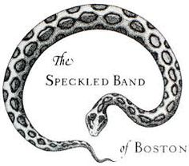
Summary
In The Adventure of the Speckled Band, Sherlock Holmes investigates the case of a young bride to be who fears that she'll be murdered. Helen Stoner, the stepdaughter of Sir Grimesby Roylott, has reason to believe that her stepfather killed her sister—she just doesn't know how. At the end, Holmes discovers that Roylott was using a snake (the "speckled band").

Slide 18
Interesting Aspects about the story
In The Adventure of the Speckled Band, Sherlock Holmes investigates the case of a young bride to be who fears that she'll be murdered. Helen Stoner, the stepdaughter of Sir Grimesby Roylott, has reason to believe that her stepfather killed her sister—she just doesn't know how. At the end, Holmes discovers that Roylott was using a snake (the "speckled band").

Slide 19
Your Views
This story has a message in it, and the main idea is that money is not the most important thing in our lives and sometimes it is the bigest problem in huge families.
Some people think about money more than about feelings and values.

Slide 20
Work done by:
Gustavo, nº8
Inês Agostinho, nº9
Joana, nº11
Mariana Santos, nº17
6º F 2016/2017

